Slide 1

Code Mastery: IoT, SQL Azure, and PowerBI Larry Heppelmann & Vanessa Cerda
August 1, 2017
Notes:
If your system doesn’t have the CORDIA NEW font, please use “Title Slide (Alt)”

Slide 2

Agenda
Intro –
A look into gathering IoT data, bringing it into Azure Stream Analytics, and surfacing it in real time in Power BI
Overview of our demos
Demo 1
Demo 2
Key twitter words #CodeMastery #Magenic #Azure
Q/A
LarryH@magenic.com
VanessaC@magenic.com

Slide 3

Demo overview
Demo 1:
Social media analysis in real time.
We will be gathering twitters (tweetage?) and analyzing data in real time.
Demo 2:
Tracking heat and humidity from a Rasberry Pi sensor.
Capture data Stream data Visualize data

Slide 4
Demo Tasks
Create Azure Event Hub or IoT Hub
Connect to event source (websites, apps, machinery, devices)
Create Stream Analytics Job
Job input (Event hub data)
Specify job query
Job output (stream to Power BI)
Start the job
Create PowerBI visualizations

Slide 5
Event Sources
Demo 1 requirements
Twitter account
Twitter App
Consumer Key
Access Token
Twitter Client App
Downloaded from interweb
Open in VS to configure settings
Demo 2 requirements
Rasberry Pi Simulator

Slide 6
Key points to demo
Azure Event Hub, Azure IoT Hub
Azure Event Hubs is an event processing cloud service that can ingest millions of events per second and make them available for storage and analysis. Whether the data originates from websites, applications, machinery, or mobile devices, Event Hubs can log events in near real-time.
The Microsoft Azure IoT Device SDKs contain code that facilitate building devices and applications that connect to and are managed by Azure IoT Hub services. The Microsoft Azure IoT Service SDKs help you to build applications that interact with your devices and manage device identities in your IoT hub.

Slide 7
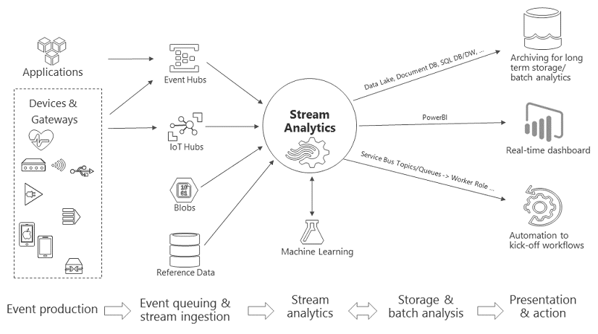
Key points to demo
Stream Analytics Job

Slide 8
Build Solution
While we build the solution, if you do not have a Twitter account, it may be fun to sign up for one and participate in the demo.
Go to http://twitter.com/signup
Name
Phone number
Password
Verify account via SMS text message
Choose username
*LarryIsARockGod is taken.☹
Key words we are looking for #codemastery #magenic #realtimedata

Slide 9


Presentation and Reporting
PowerBI
SQL Server Reporting Services
Splendid reporting, data self discovery, mashups, dashboards, can consume a wide variety of data with more capabilities being constantly added. Both powerful and easy to use. Highly cost effective. Clients for Desktop, Mobile, and Web.
Traditional SSRS running in a VM. Good intermediate alternative to migrating reporting to the cloud. Also if Push reporting is needed.
Premise based reporting
Others
A hybrid network topology would allow data in the cloud to be used on the premise
Desktop tools such as Tableau, Qlik, SAS, Spotfire , Micro-Strategy.
Some of these have cloud/service offerings.
Don’t forget MS Excel w. Power* Tools!
Oracle Reporting and many 3rd party reporting tools are available as VMs (IaaS).

Slide 10
Demonstration
We will build one solution to capture key words from Twitter and then create an Event Hub and a Stream Analytics job to gather the data and analyze it in real time using PowerBI.
We will build another solution that connects to a Rasberry Pi (simulated) heat and moisture sensor using an IoT hub. We will create a Stream Analytics job to stream the data into Power BI and visualize it in real time.

Slide 11
Contact Info:
Name: Larry Heppelmann
Email: larryh@magenic.com
Name: Vanessa Cerda
Email: vanessac@magenic.com
Thank you !

Slide 12
Azure Pricing
SQL Azure:
https://azure.microsoft.com/en-us/pricing/details/sql-database/
Stream Analyics:
https://azure.microsoft.com/en-us/pricing/details/stream-analytics/
IoT Hub:
https://azure.microsoft.com/en-us/pricing/details/iot-hub/

Slide 13
Demo Resources
Twitter Demo:
https://docs.microsoft.com/en-us/azure/stream-analytics/stream-analytics-twitter-sentiment-analysis-trends
Rasberry Pi:
https://docs.microsoft.com/en-us/azure/iot-hub/iot-hub-raspberry-pi-web-simulator-get-started

Slide 14


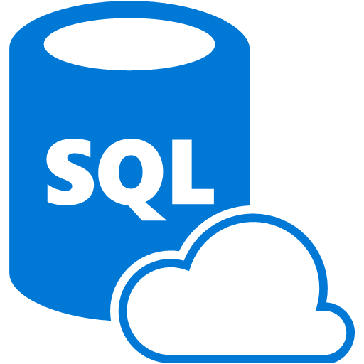


Date in Motion: Real-time and Near Real-time
Messages from the front half
Business Decision Makers
Azure
Stream
Analytics
Azure
SQL
Real-time data stream
Near real-time relational data
Stream Analytics Highlights
High throughput, low latency processing of real-time events from devices (sensors, apps, devices, etc.)
Potential to handle millions of events/second while correlating data from multiple streams
Reference data (from blob storage) can be added to computations to decorate and enrich information
Intended as a companion service, not replacement, for batch-based processing
Must be implemented as part of a pipeline with other services to provide demonstrable value

Slide 15
The IoT Cloverleaf
The “Front Half”
IoT
Ingestion
Storage
Command & Control
Analytics and Presentation
The “Back Half”

Slide 16




Ingestion / Communication
IoT Hub
Event Hub
Provides device registration and management, Bi-directional communication, and High scale
Designed for massive telemetry ingestion, Geo-Scaling, Message partitions and consumer groups
Alternative to: Kafka
Web Services
Other
Provides high scale when specialized behavior is needed, that can expose APIs that are useful across the enterprise
There are other alternatives emerging many which support specialized protocols for industry scenarios

Slide 17




Notifications in Azure
Notification Hub
SendGrid
Notification Hub is the native Azure solution that offers push notifications to Apple IOS, Google Android.
SendGrid is the most popular e-mail choice for Azure as it has many nice features and it’s API is straight forward and offers analytics and marketing support
Amazon SNS
Urban Airship and others
Amazon SNS is a cost competitive way to get e-mail in the cloud and via it’s easy to use API can be called from almost any Azure service or worker
Urban Airship and competitors offer push notifications or e-mails
Another alternative is IaaS (aka a VM) hosting an e-mail server

Slide 18


Data at Rest: Orchestrated Data Pipeline
Messages from the front half
Azure
Storage
Azure
SQL
Business Decision Makers
Data
Factory
Raw messages as BLOBS (in JSON)
Orchestrate and transform
Relational storage
Data Factory Highlights
Orchestrates and automates the movement of data through a managed pipeline
Provides the ability to transform raw data by hooking into other linked services (HDInsight, etc.)
Similar to SQL Server Integration services, in that it creates ETL-like data flows between target and source
Similar to SQL Agent, in that it has job scheduling and execution capabilities
Unlike SSIS, Data Factory is not GUI-focused (although getting there), and as an Azure PAAS offering, it has no dependencies on SQL Server
Think SSIS meets BizTalk system integration in the cloud

